Slide 1
Open Source Intelligence
Offensive Security

Slide 2
Open Source Intelligence
Used to gather data from public sources
Media, newspapers
Business documents, publications
Internet…
Generally very passive
Never touching the target
Public information may reveal a lot about an organization
Sources may not always be true

Slide 3
Where does OSINT fit in Penetration Testing/Red Teaming?
Methodologies
PTES
OWASP
OSSTMM
NIST SP 800-115
Output of OSINT is input to the next step
Threat modeling/vulnerability analysis/exploitation

Slide 4
Why OSINT?
One of the most important parts of an assessment
Foundational work
Helps to build plan of attack
Social Engineering
Useful information using during assessment
OSINT information in a report is value added

Slide 5
Targets of OSINT
Based on scope and goals of test
Different end goals might require different intel
Business
User
Network
Creating plan of attack based on this information

Slide 6
Types of Information – Business
Organizational Information
Who they are
What they do
Relationships with other companies
Comes in the form of
Physical location, Size, Partners, Records, Organization structure
Product Information, Patents
Technology in use, Employees
Job openings
Affiliations
Public document metadata
Org Chart

Slide 7
Types of Information – User
Employee Information
Who they are
What they do
Organizational chart
Username/password
Found in various places
Job/Role, Previous Jobs
Email addresses

Slide 8
Types of Information – Network
Addressing
Flat network vs Separated
Technologies
Remote access
VPN
Email
Defenses
Network based
Host based

Slide 9
Google/Bing/[Search Engine]
If no pre-existing information is given, start by searching
All the information mentioned previously
Search operators
Intitle:
Type:
Site:
Info:
Loc:

Slide 10

Google Cache/Wayback Machine
Services caching data on the internet

Slide 11
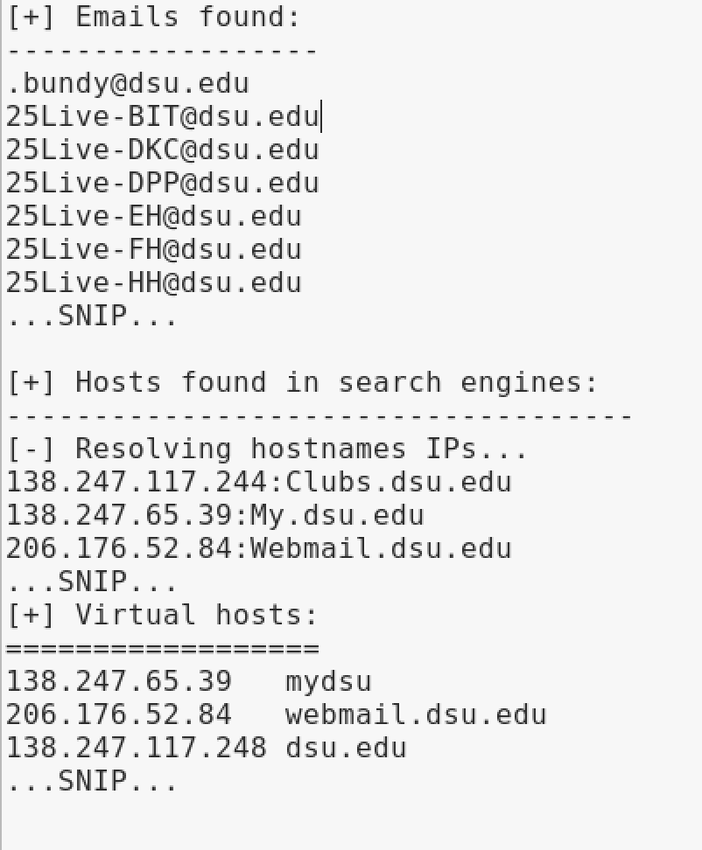
theHarvester

Slide 12
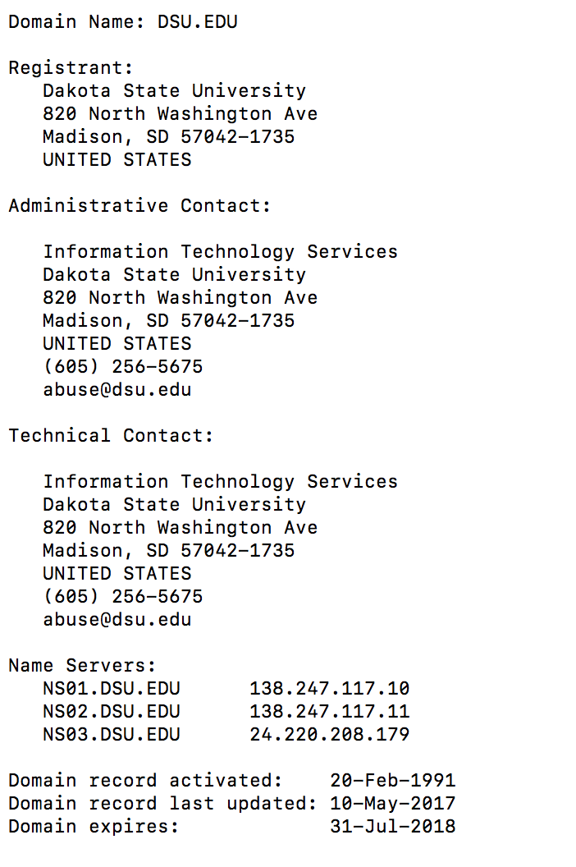
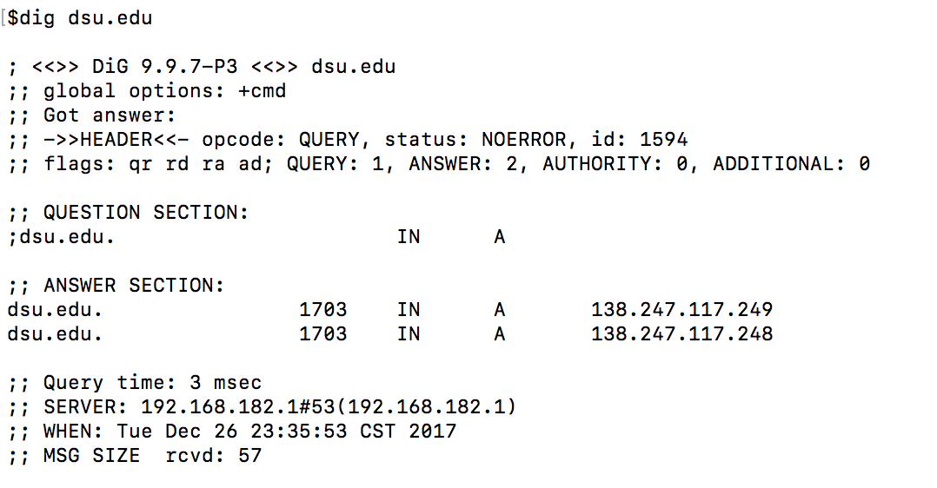
Whois/Dig

Slide 13
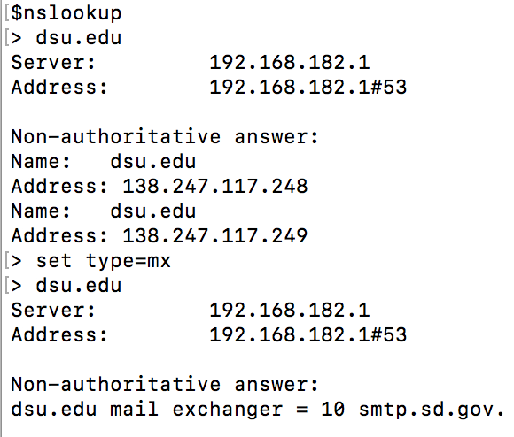
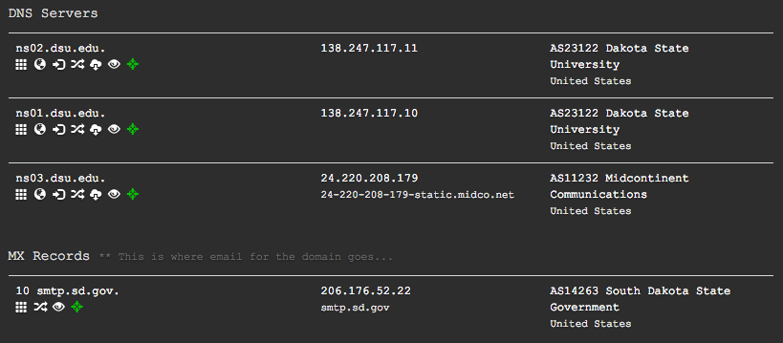
DNS

Slide 14
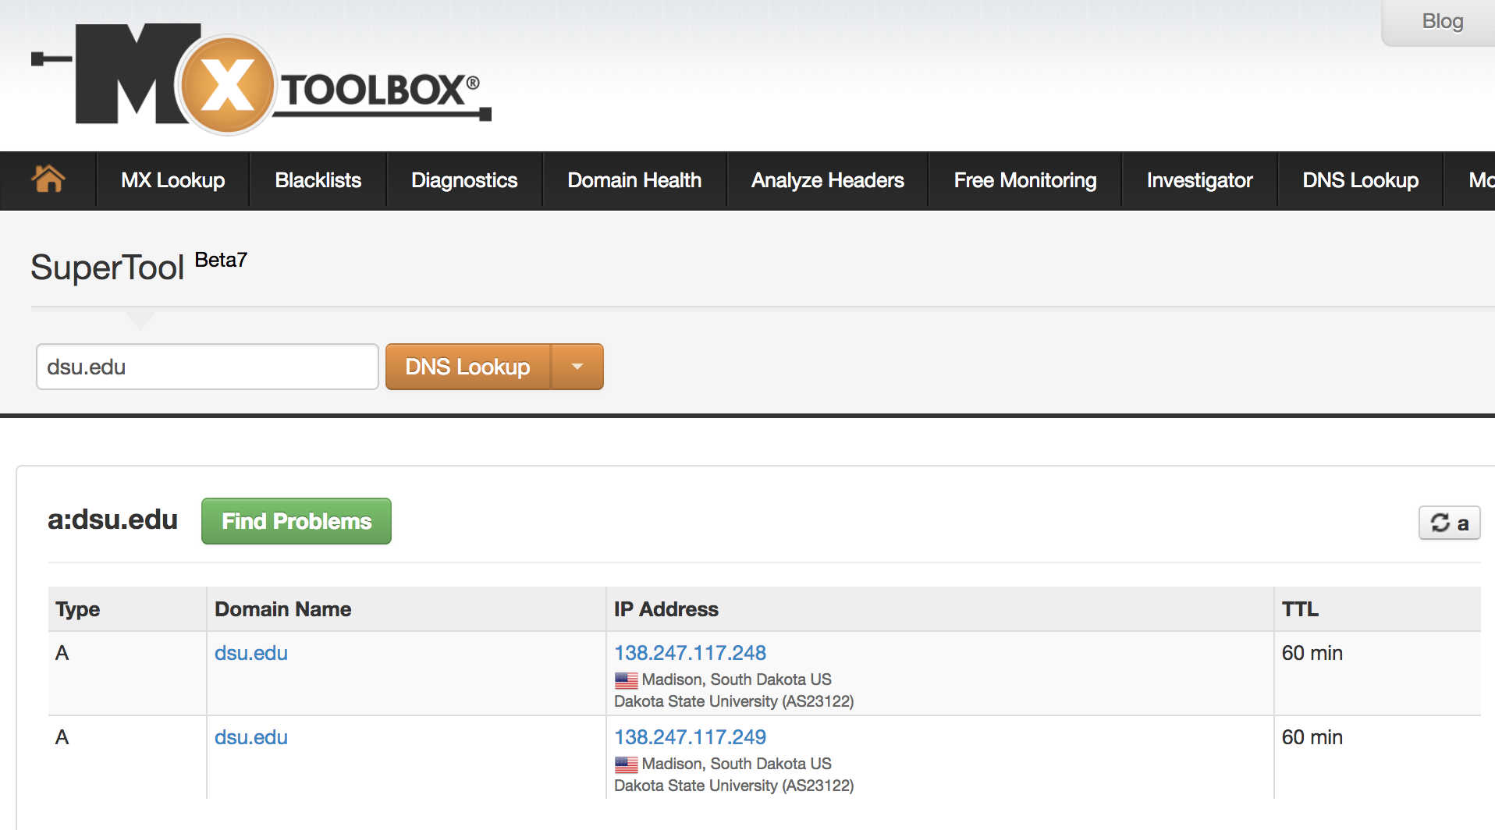
MxToolbox/DNS Dumpster

Slide 15
Discover Scripts
https://github.com/leebaird/discover
Recon
Scanning
Web
Misc

Slide 16
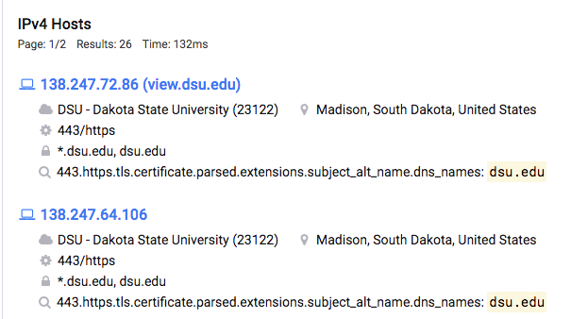
Shodan/Censys
Internet search engines
Actively scanning the Internet
Discover services running

Slide 17
Employee Information
Setting the stage for phishing
Knowing about them gives information about an organization
Social Media
Other Search Engines
Spokeo

Slide 18
Social Media
LinkedIn
Facebook
Twitter
Etc.

Slide 19
Recon-ng
Demo
Notes:
DEMO TIME!!! With recon-ng
create a new space and add dsu
workspaces add dsu.edu
add domains dsu.edu
find some hosts using osint
load netcraft
run
load bing_domain_web
run
load google_site_web
run
load brute_hosts
run
get ip addresses
load recon/hosts-hosts/resolve
run
load recon/hosts-hosts/reverse_resolve
run
geolocation
***need api keys
contacts
load whois_pocs
run
load pgp_search
run
reporting
use html
set creator YOURNAME
set customer idk
run
iceweasel PATH/TO/REPORT

Slide 20
Other Tools
OSINT Framework
Metagoofil
Maltego
Etc…

